Slide 1



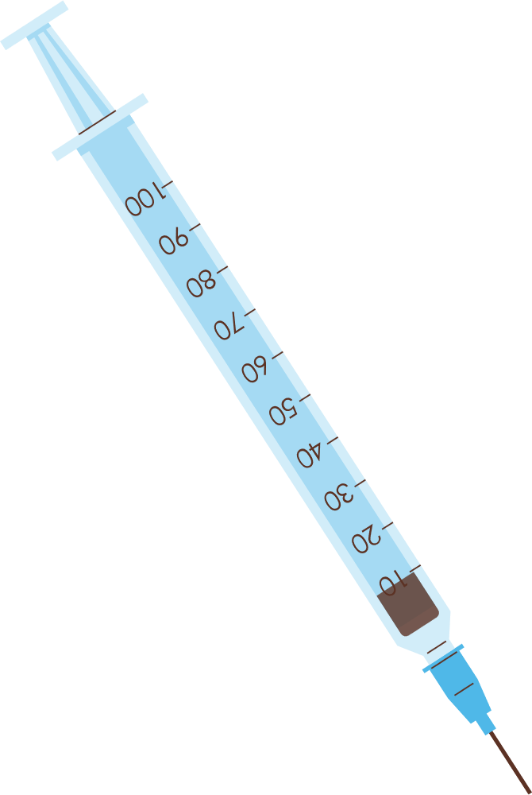



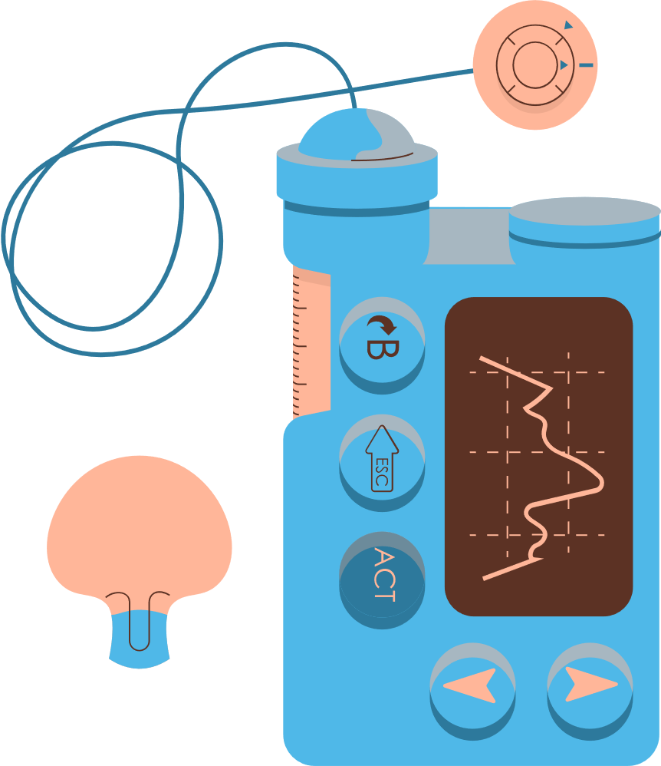



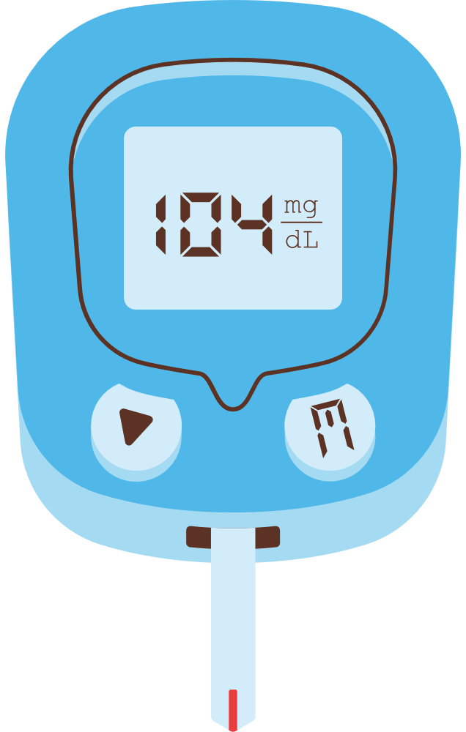

Weighted Federated Learning with Encryption for Diabetes Classification
Present by: Zhiyi Yue
Authors: Puyang Zhao, Zhiyi Yue, Xinhui Liu, Jingjin Wu

Slide 2
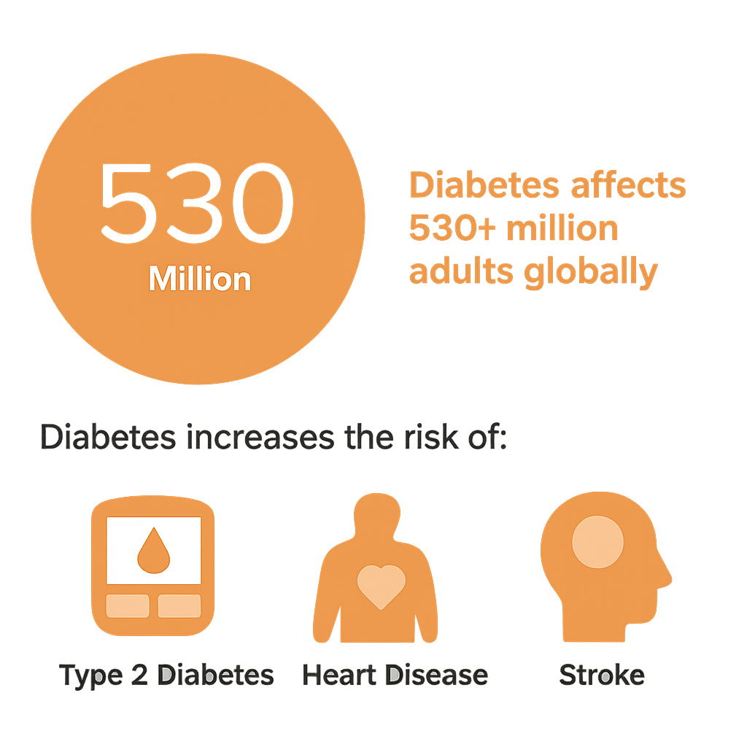

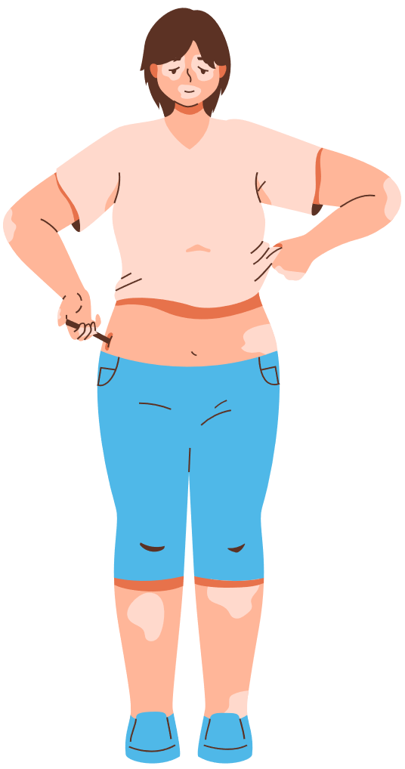

A Global Health Crisis

Slide 3


Motivation & Challenges
Traditional machine learning methods:
Centralized models trained on pooled datasets
Examples: Logistic Regression, SVM, Random Forest, Deep Neural Networks
Problems:
❌ Require access to all data in one location
❌ Privacy laws (e.g., HIPAA, GDPR) prohibit such sharing
❌ Lack generalizability due to homogeneous training data

Slide 4

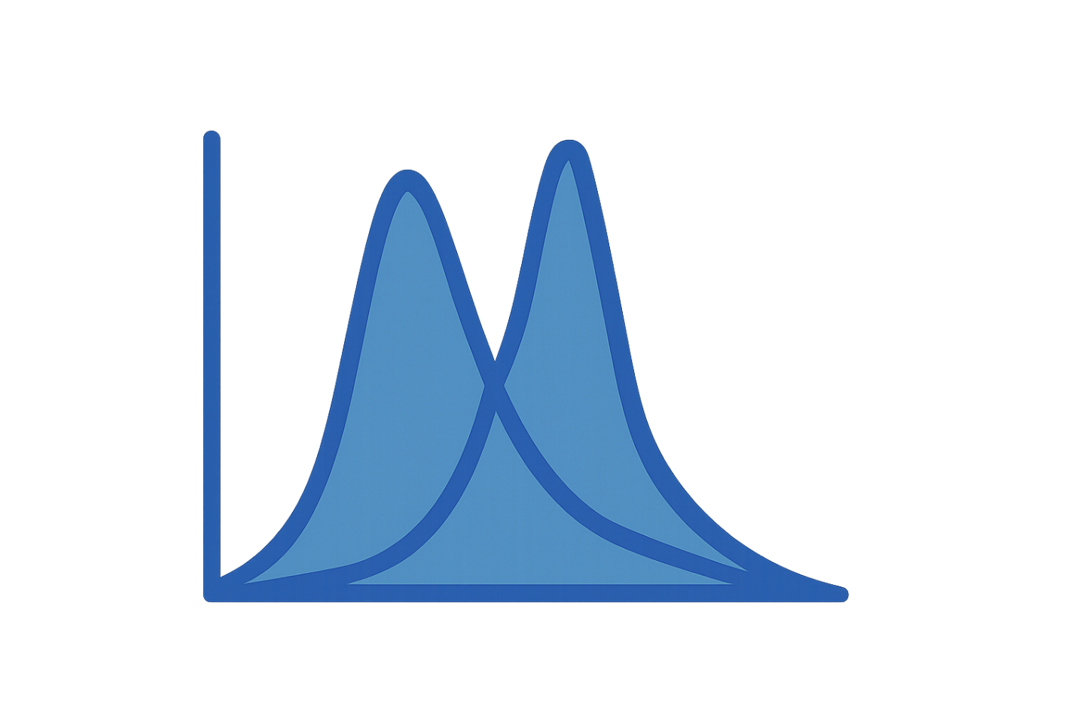


Motivation & Challenges
Why this work?
Healthcare data are fragmented across institutions and highly sensitive.
Centralized AI models struggle with:
Privacy risk
Data imbalance
Non-IID (heterogeneous) distributions
Goal:
Develop a privacy-preserving, robust, and scalable AI framework for diabetes classification across institutions.

Slide 5

Solution Overview
Proposed Framework:
Weighted Federated Learning (FL)
Lightweight Encryption
Support for both classical ML and deep learning
Interpretability via SHAP
FL trains models collaboratively without sharing raw data.

Slide 6

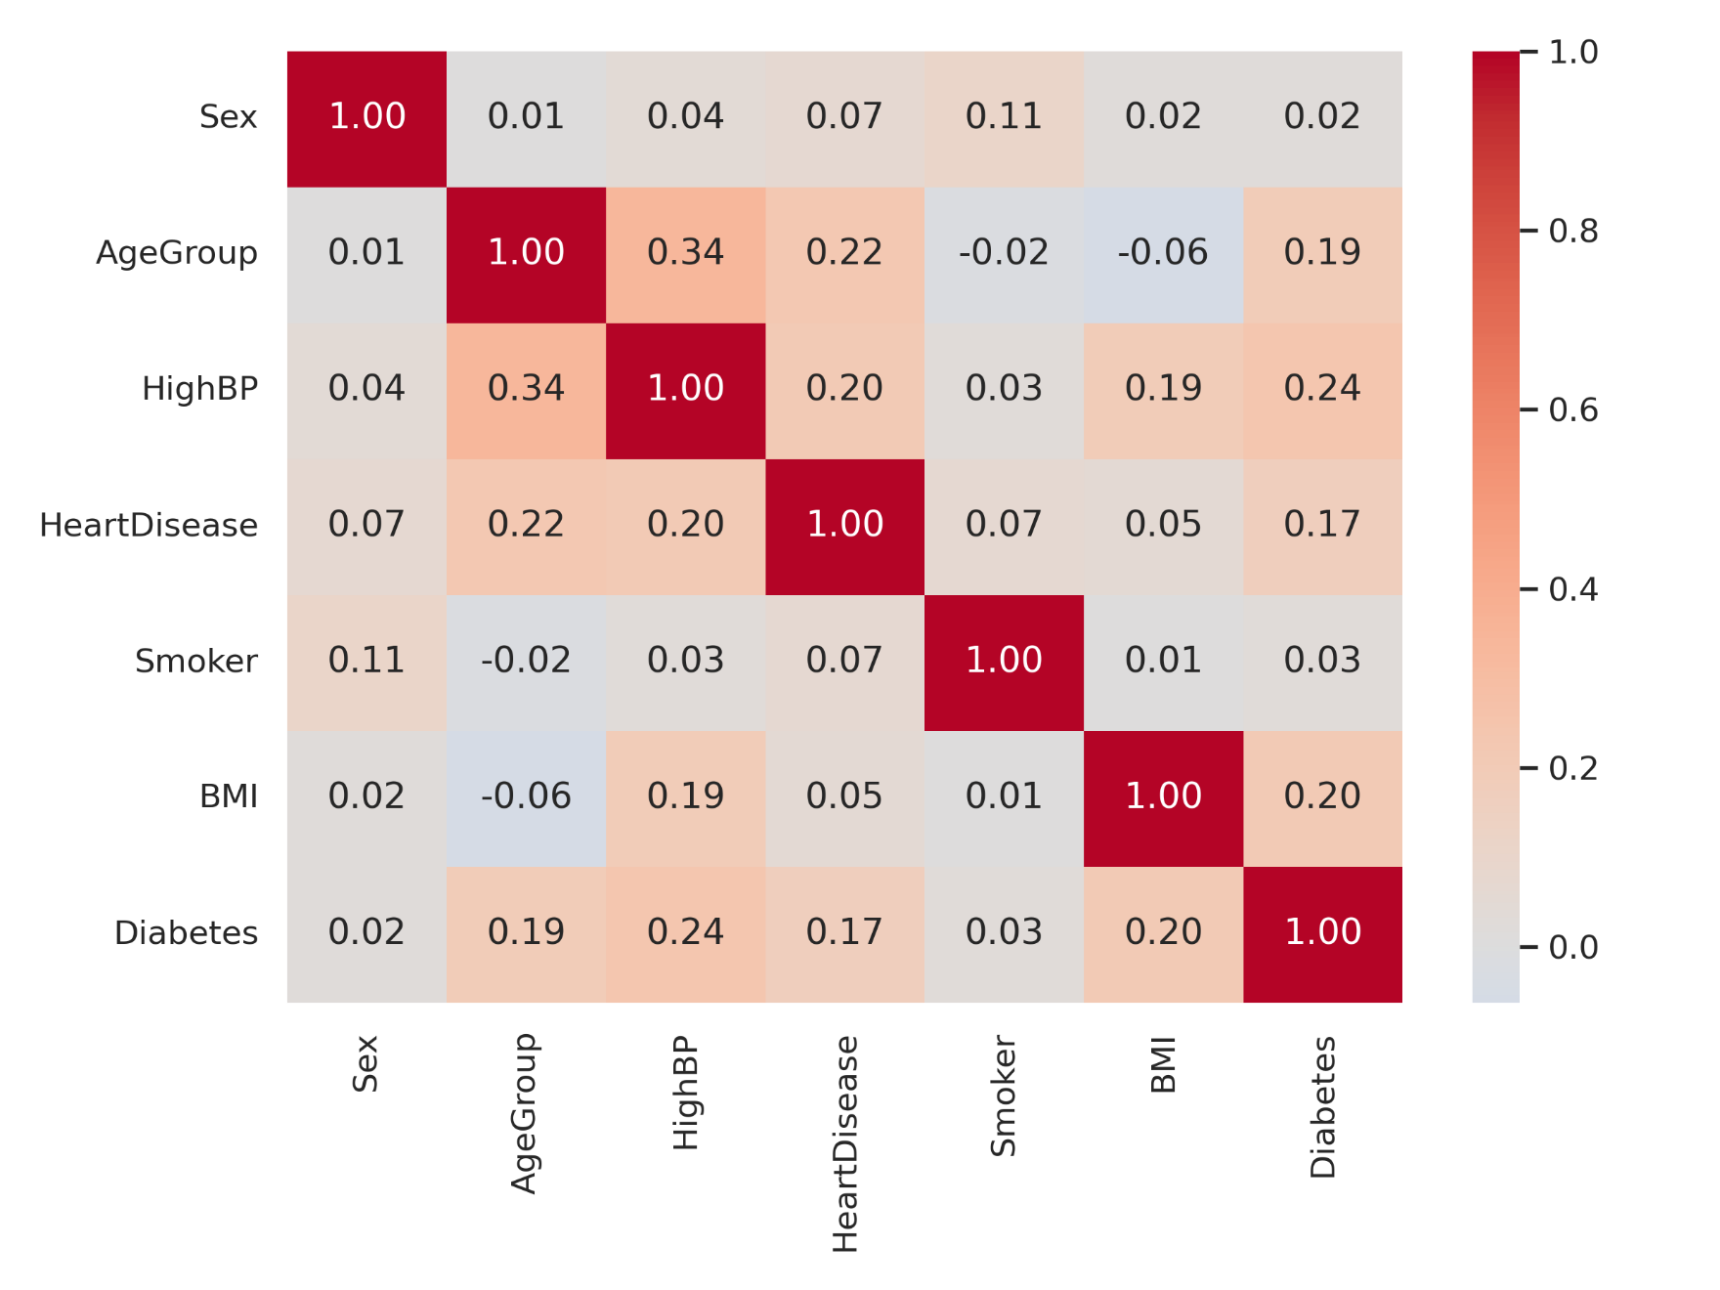
Dataset & Preprocessing
Source Institutions:
ADCES: 4,995 samples
CDC: 5,172 samples
IDF: 5,180 samples
Total: 15,347 records
Local Preprocessing (per site):
Imputation
Normalization
Anonymization
→ Ensures privacy, standardization, and non-leakage

Slide 7
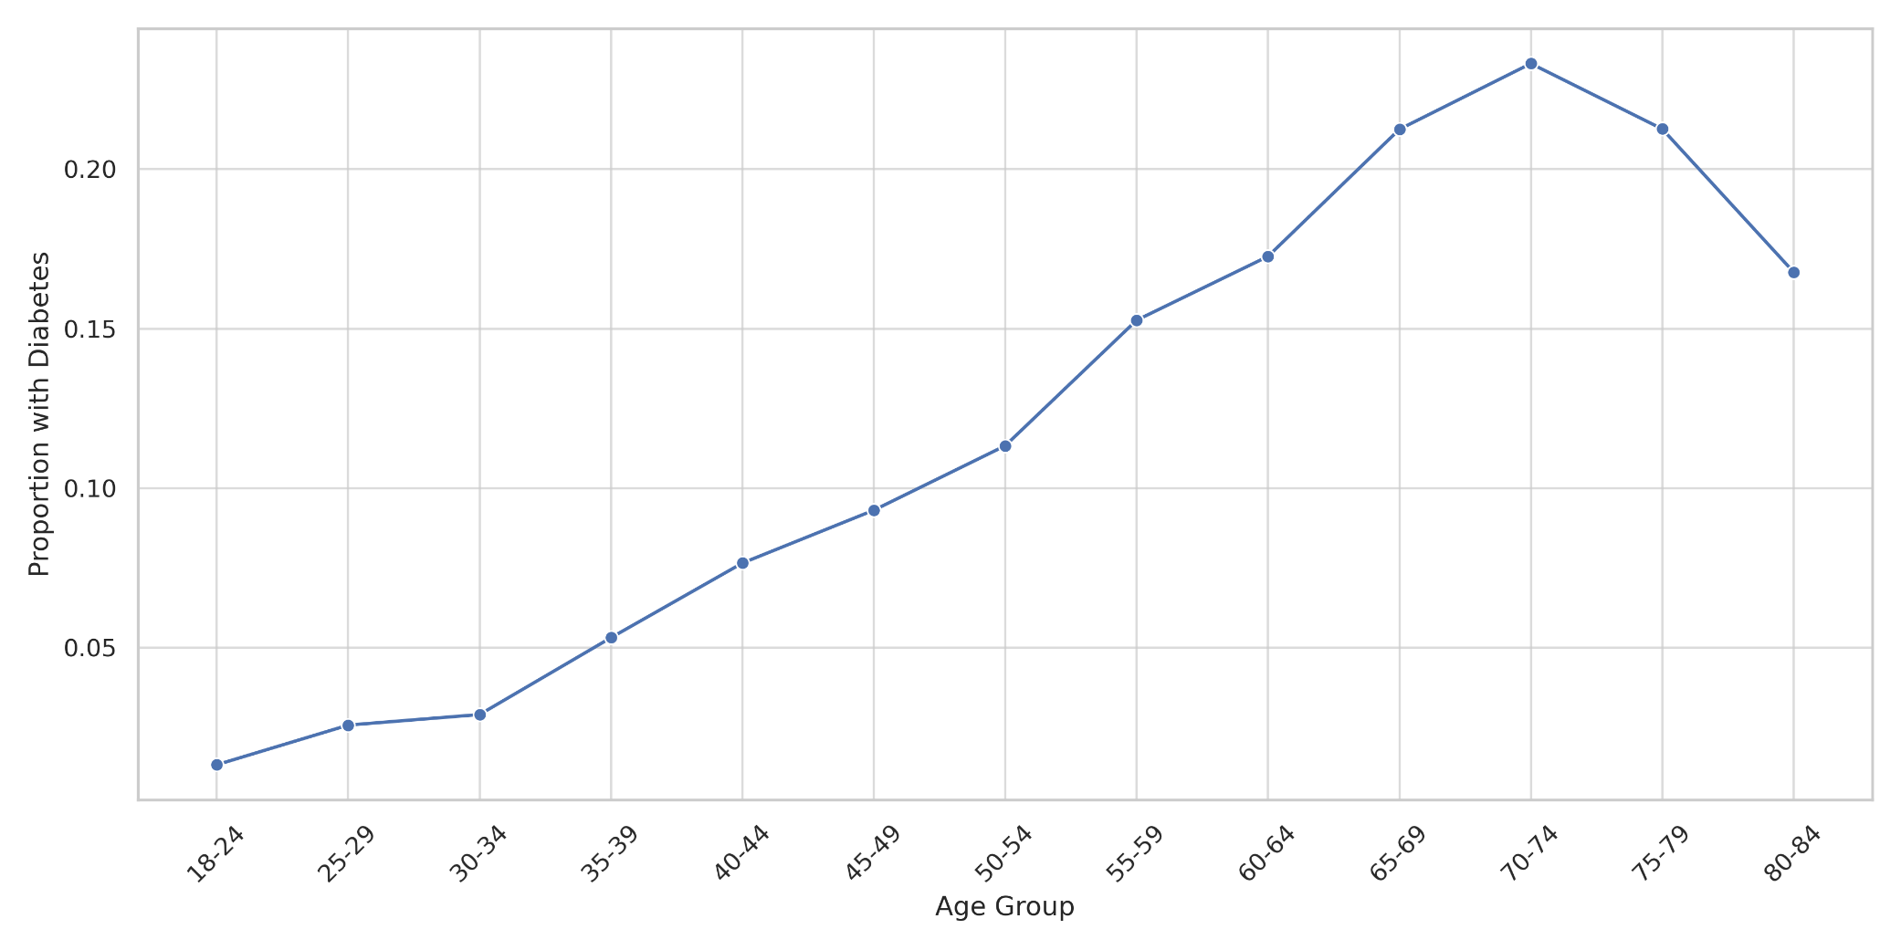
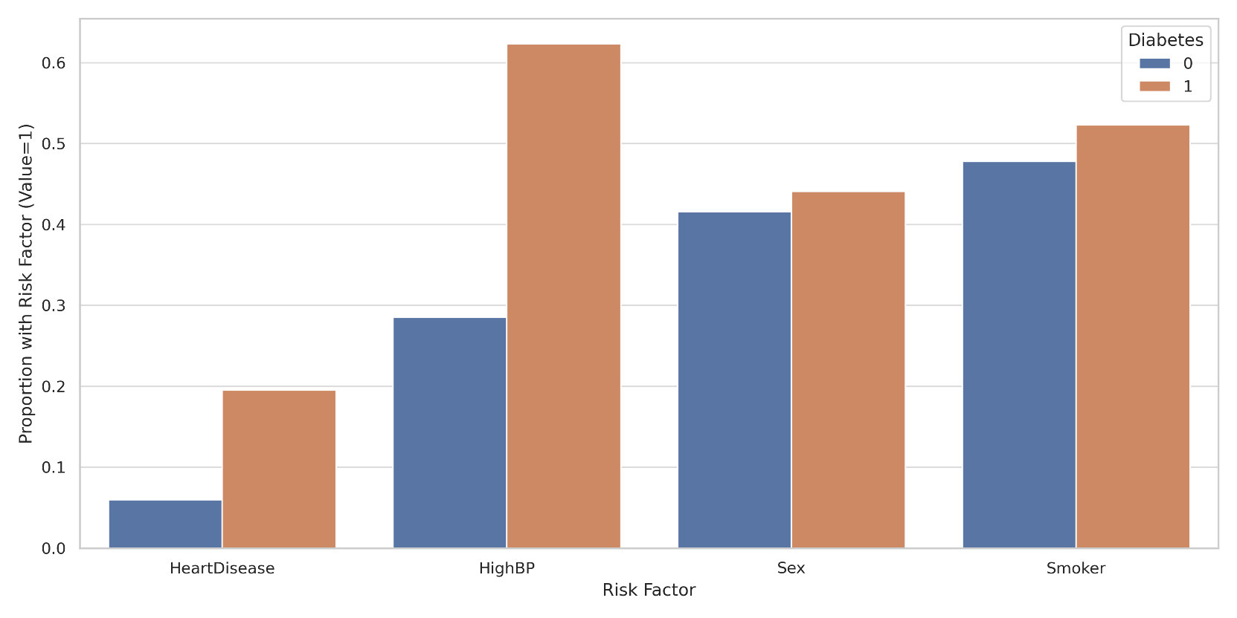
Feature Risk Profiles
Diabetics more likely to have:
High blood pressure
(61% vs 29%)
Heart disease (20% vs 7%)
Smoking history
No major sex imbalance
📈 Sharp increase after age 55 👵 Peak: 70–74 age group

Slide 8
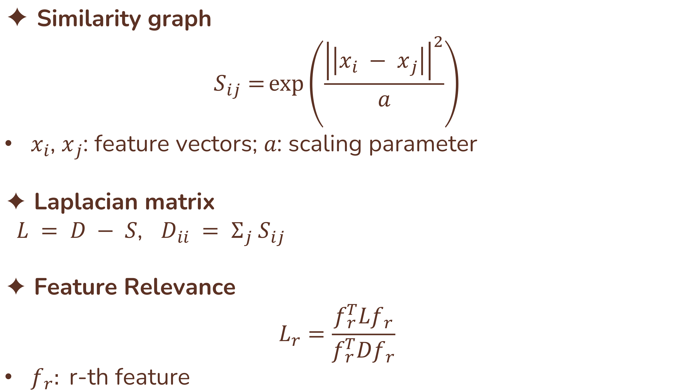
Feature Selection: Laplacion Score
✦ Similarity graph
$$S_{ij}=\exp\left(\frac{{\left|\left|x_{i} − x_{j}\right|\right|}^{2}}{a}\right)$$
$x_{i}$, $x_{j}$: feature vectors; $a$: scaling parameter
✦ Laplacian matrix $L = D − S$, $D_{ii} = Σ_{j} S_{ij}$
✦ Feature Relevance
$$L_{r}=\frac{f_{r}^{T}Lf_{r}}{f_{r}^{T}Df_{r}}$$
$f_{r}:$r-th feature
Lower, more important

Slide 9
Weighted FL: Overview
✦ FL basics
Clients train locally on their data
Server aggregates local updates
Raw data never shared → privacy preserved
Clients have unequal dataset sizes
Challenge
Data distributions are often non-IID
Simple averaging (FedAvg) may bias results
✦ Weighted FL idea
Clients with larger datasets get more influence
Use dataset size to assign weights

Slide 10
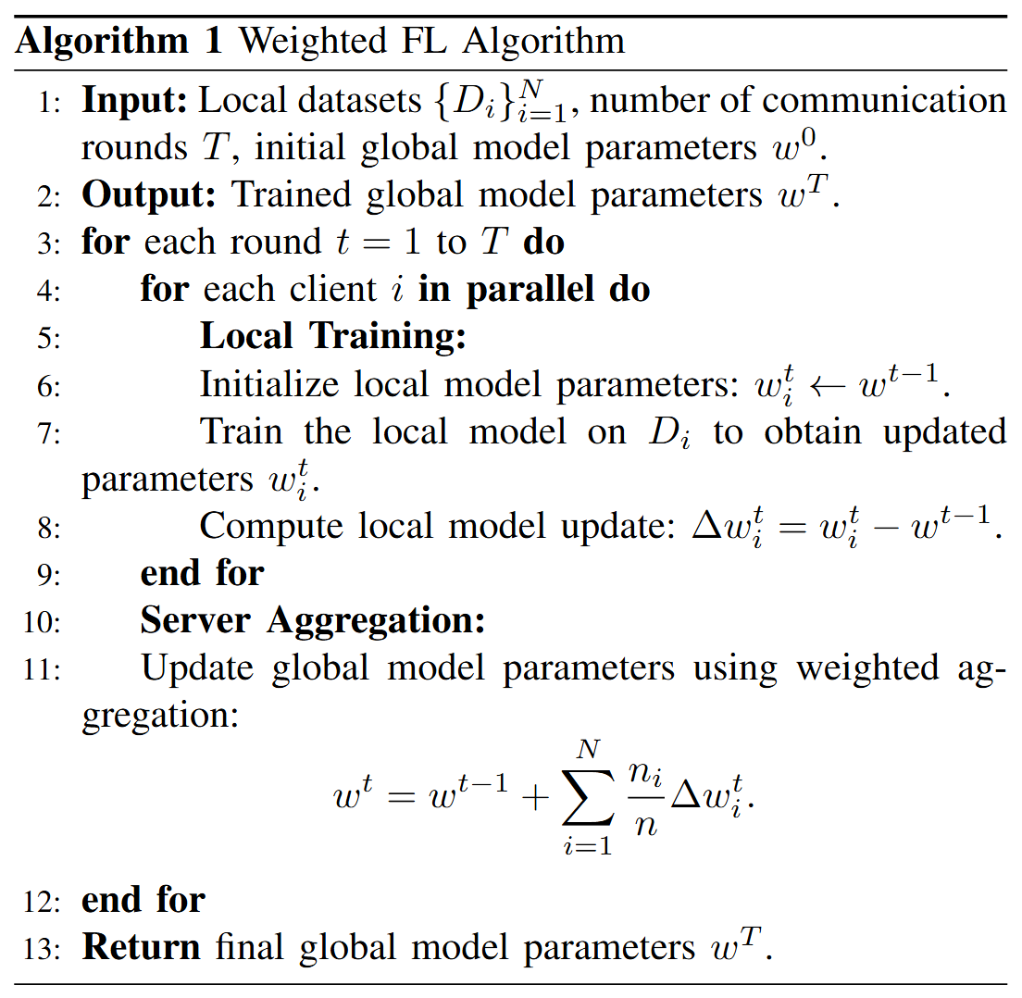
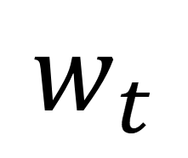
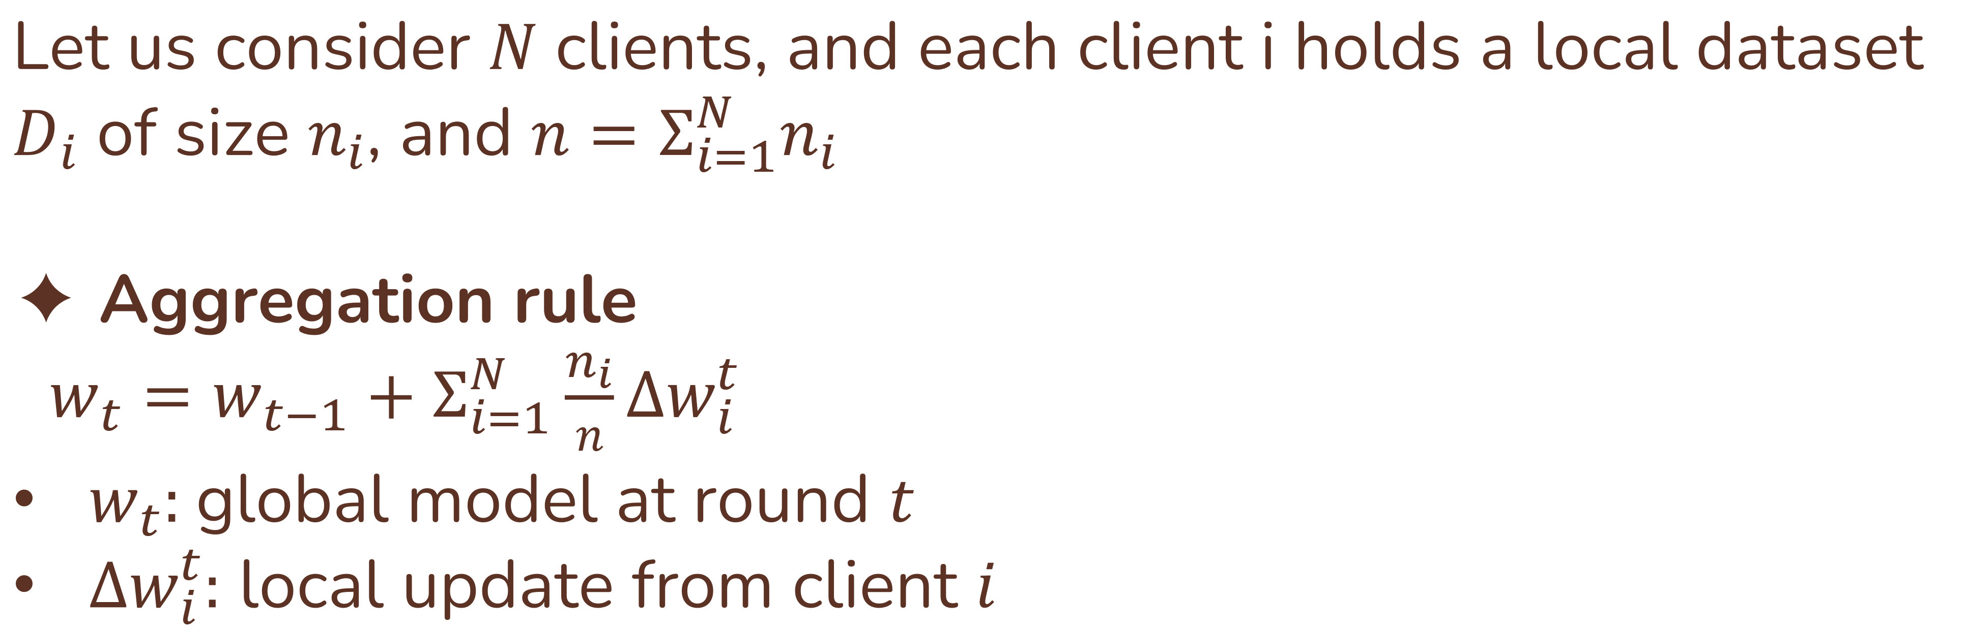
Weighted FL: Aggregation
Let us consider $N$ clients, and each client i holds a local dataset $D_{i}$ of size $n_{i}$, and $n=Σ_{i=1}^{N}n_{i}$
✦ Aggregation rule $w_{t}=w_{t−1}+Σ_{i=1}^{N}\frac{n_{i}}{n}∆w_{i}^{t}$
$w_{t}:$ global model at round $t$
$∆w_{i}^{t}:$ local update from client $i$
C
Distributed back to all clients for the next training round
$$w_{t}$$
Serves as the final global model for prediction once training converges

Slide 11
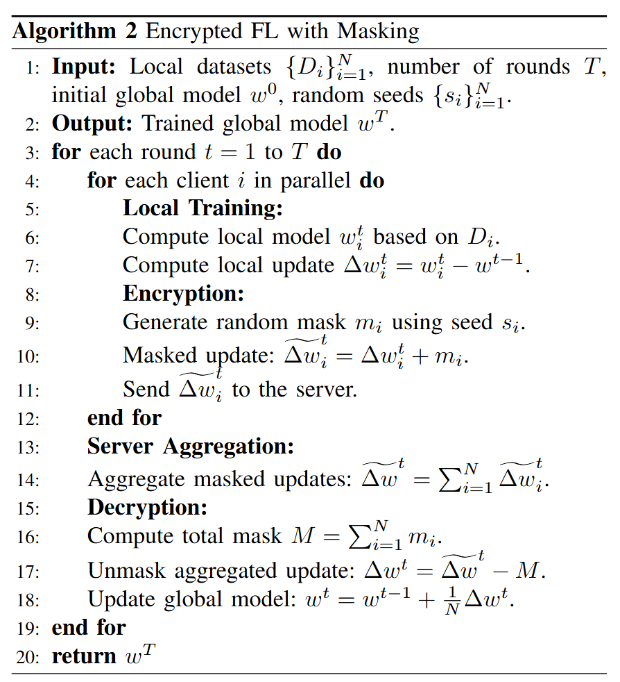
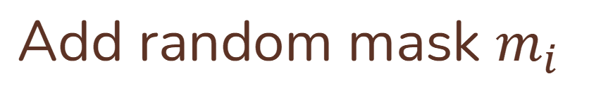
Weighted FL: Encryption Phase
To enhance privacy, we incorporate an encryption phase using a masking technique during the transmission of local model updates. This method ensures that individual updates remain confidential.
Key points:
Individual updates remain confidential
Masks cancel out after aggregation
Ensures privacy without affecting learning outcome
Add random mask $m_{i}$

Slide 12
Machine Learning Models
Centralized learning
Data from all participating institutions are aggregated into a single dataset
Trains machine learning models on the full spectrum of data
Ignores privacy and decentralization concerns
Machine learning models - algorithms benchmarked (both Centralized & Federated):
LR – Logistic Regression: coefficients averaged in FL
RF – Random Forest: global prediction = average of local forests
SVM – Support Vector Machine: decision scores averaged in FL
DNN – 3-layer feed-forward NN (PyTorch, FedAvg)
Deeper DNN – 5-layer NN with larger hidden dimension (PyTorch, FedAvg)

Slide 13
Performance Comparison
Model | Framework | Weighted F1 | AUC | Precision | Recall
LR | Centralized | 0.81 | 0.78 | 0.81 | 0.86
 | Federated (No Enc.) | 0.82 | 0.76 | 0.82 | 0.87
 | Federated (With Enc.) | 0.82 | 0.76 | 0.82 | 0.87
SVM | Centralized | 0.79 | 0.46 | 0.78 | 0.79
 | Federated (No Enc.) | 0.81 | 0.57 | 0.89 | 0.87
 | Federated (With Enc.) | 0.81 | 0.57 | 0.89 | 0.87
RF | Centralized | 0.82 | 0.70 | 0.81 | 0.85
 | Federated (No Enc.) | 0.82 | 0.76 | 0.83 | 0.87
 | Federated (With Enc.) | 0.82 | 0.76 | 0.83 | 0.87
DNN (3L) | Centralized | 0.80 | 0.78 | 0.83 | 0.86
 | Federated (No Enc.) | 0.82 | 0.77 | 0.83 | 0.87
 | Federated (With Enc.) | 0.82 | 0.77 | 0.83 | 0.87
Deeper DNN (5L) | Centralized | 0.80 | 0.78 | 0.88 | 0.86
 | Federated (No Enc.) | 0.81 | 0.77 | 0.76 | 0.87
 | Federated (With Enc.) | 0.82 | 0.77 | 0.83 | 0.87
Weighted FL consistently matches or surpasses centralized learning.
Classical models (SVM, RF) show the strongest improvements.
Deep models remain stable; encryption introduces no accuracy loss.

Slide 14
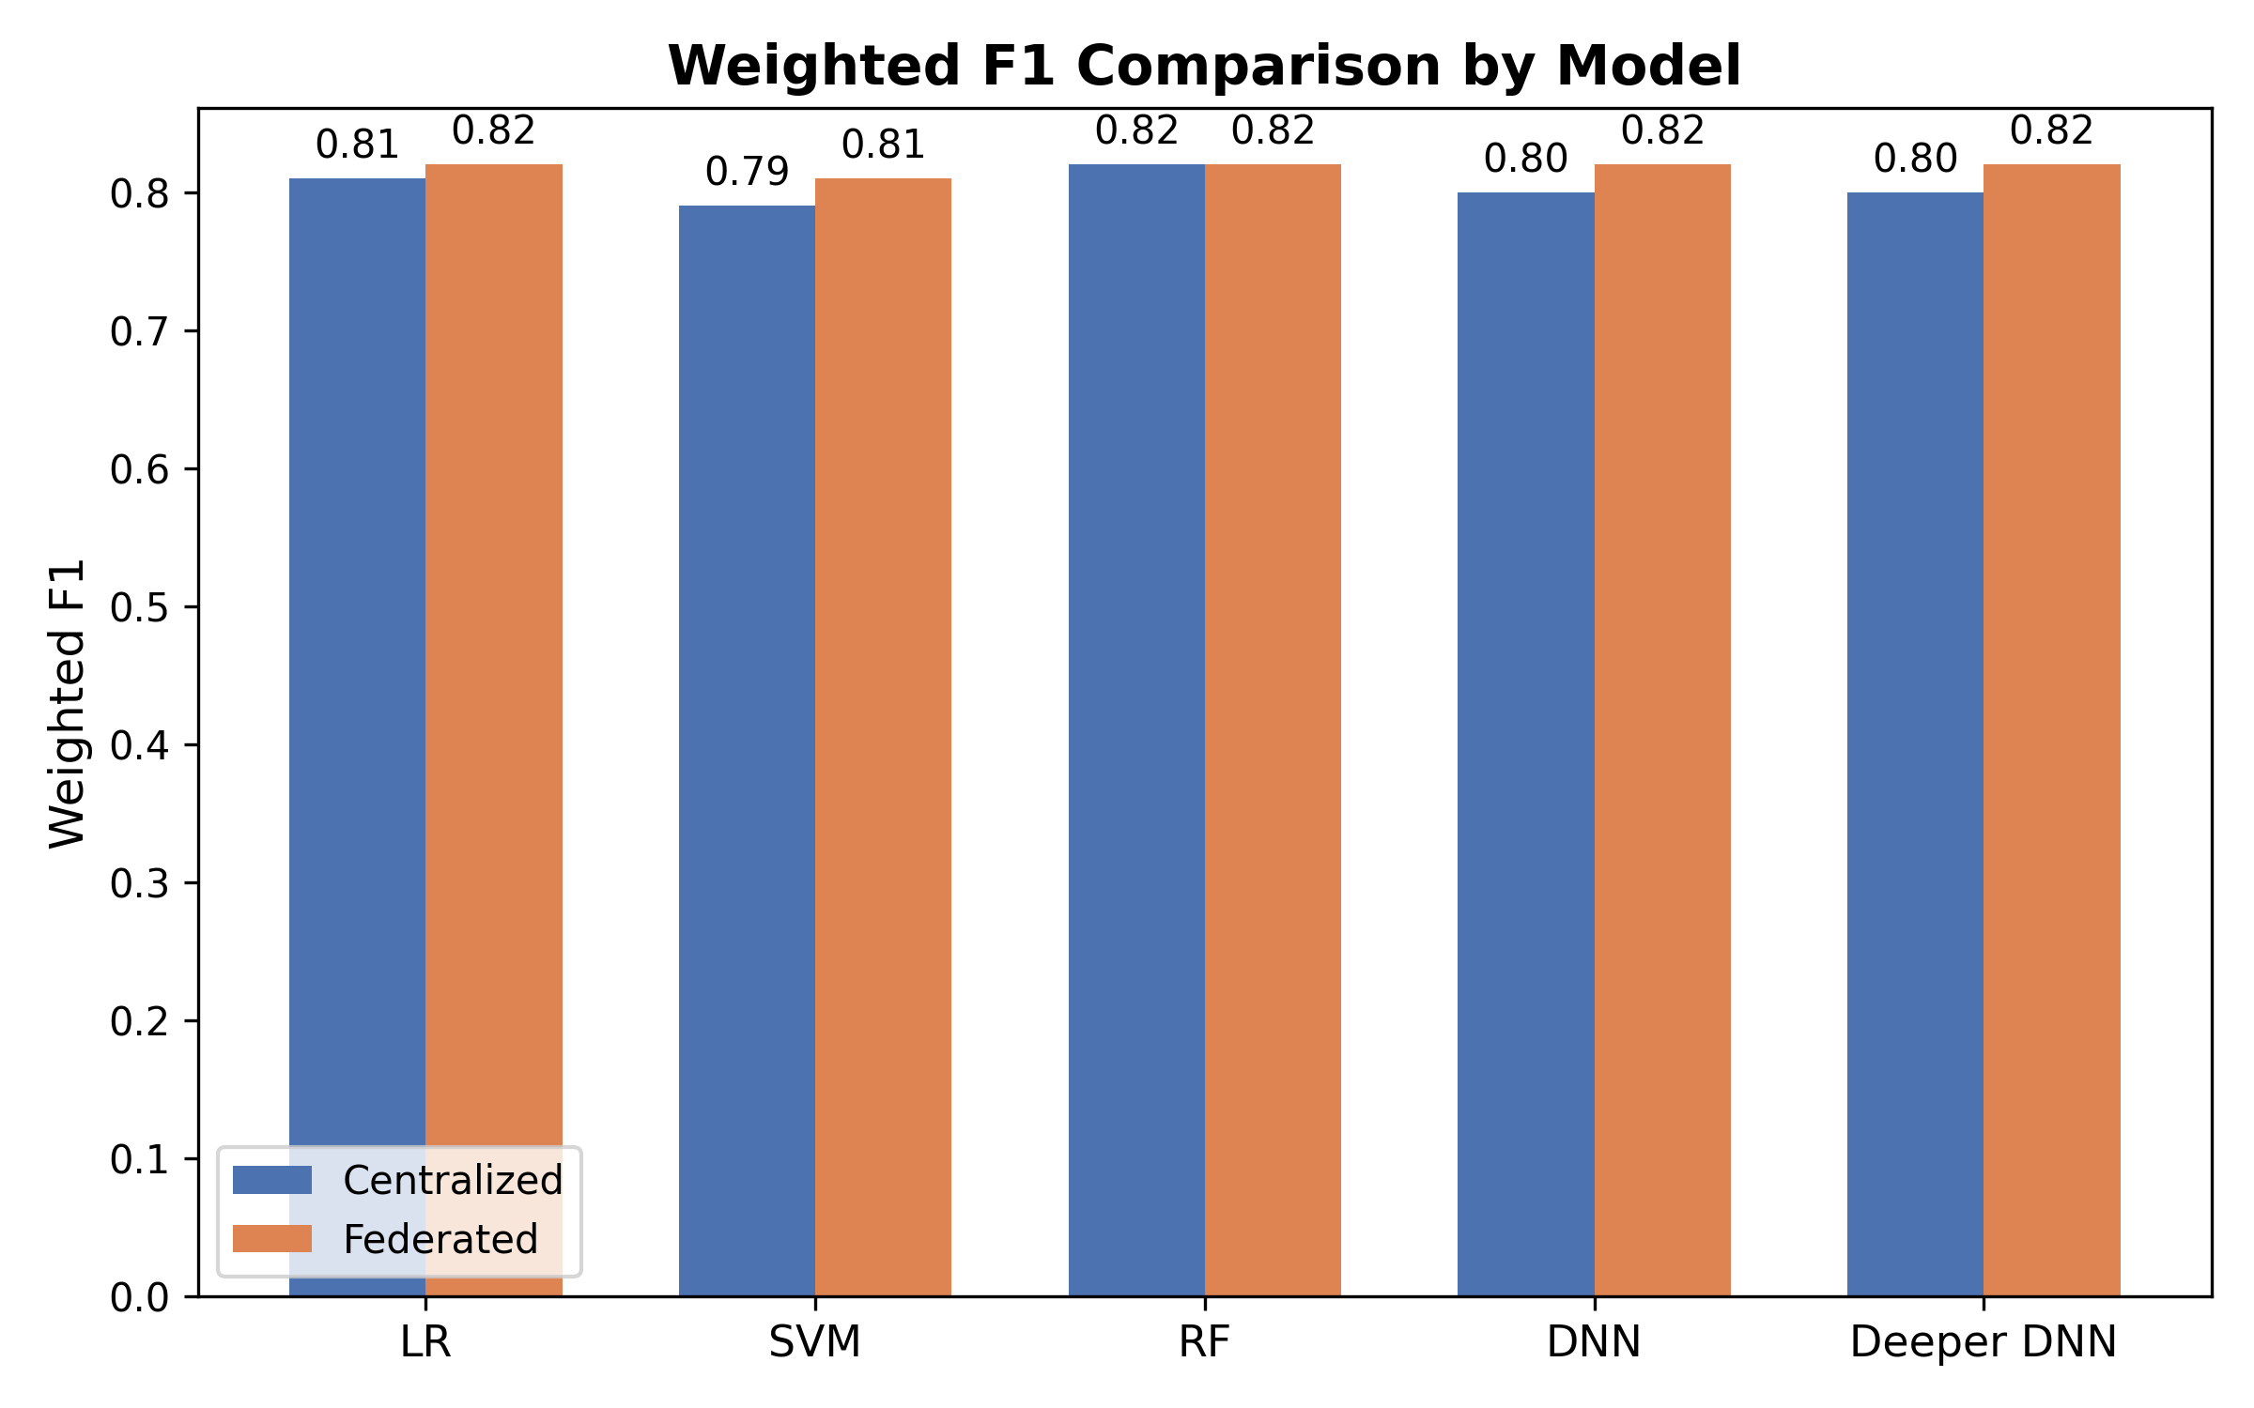
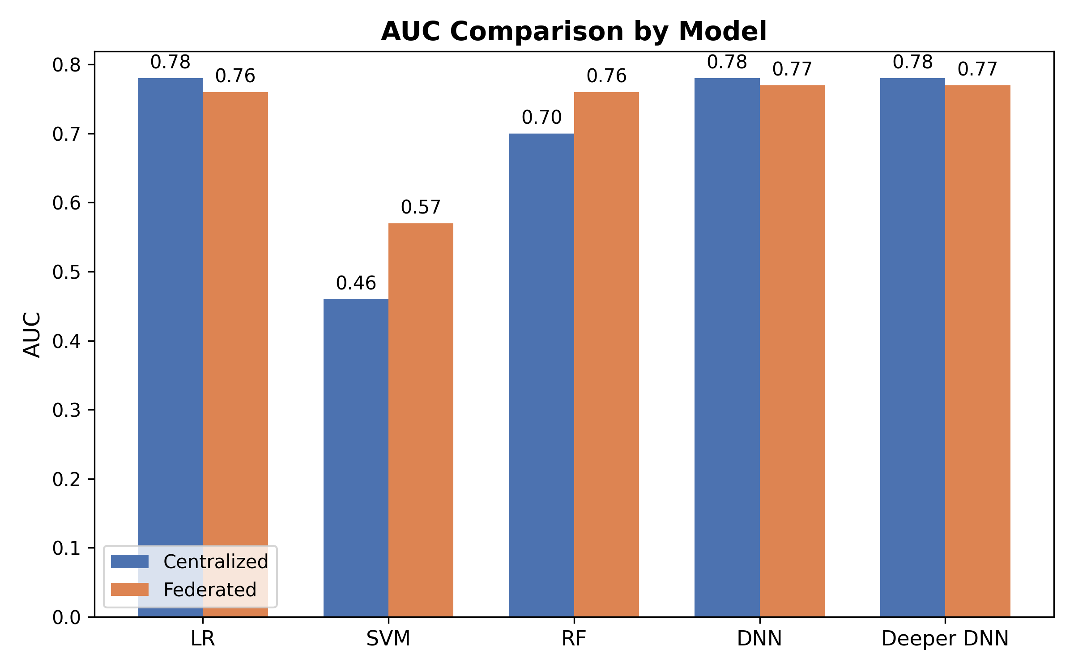
v
Model-specific Performance Gains
SVM and RF show the largest AUC gains under federated learning.
LR achieves a slight F1 improvement while maintaining comparable AUC.
DNNs remain stable in both AUC and F1, unaffected by encryption.
Classical models, particularly SVM and RF, benefit most from federated learning, while deep networks maintain stable performance without loss from encryption.

Slide 15
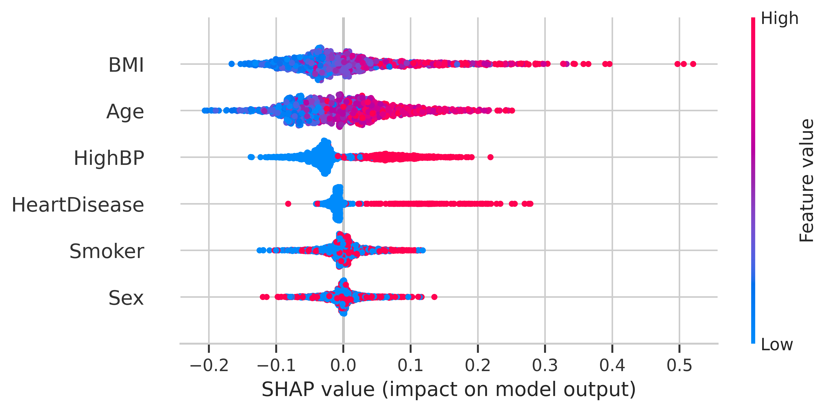
v
Feature Contributions (SHAP Analysis)
BMI emerges as the dominant predictor, strongly increasing diabetes risk.
Age, high blood pressure, and heart disease contribute significantly as secondary risk factors.
Smoking and Sex show negligible influence across most cases.
The feature impact patterns mirror established clinical knowledge, reinforcing trust and face validity of the model.

Slide 16
Encryption and Communication Overhead
Metric | Value
Avg. Encryption Time / round | 0.0001 s
Avg. Decryption Time / round | 0.0013 s
Communication cost / round | 0.16 KB
Encryption and decryption add negligible latency (0.0001–0.0013s/round).
Communication cost is minimal and stable (≈0.16 KB/round).
Privacy is preserved without accuracy loss or efficiency trade-off.

Slide 17
Conclusion
Weighted FL with encryption achieves equal or better performance than centralized learning across classical and deep models.
Privacy is preserved with negligible encryption overhead, ensuring feasibility for routine clinical networks.
Model interpretability is supported by clinically meaningful features, led by BMI and followed by key factors such as age, hypertension, and heart disease.
The framework demonstrates practical scalability for multi-institutional healthcare collaboration.

Slide 18
Limitation & Future Work
Limitations
Conducted on a cross-sectional dataset with limited features, which may restrict generalizability.
Site-level differences in coding practices and label quality were not fully addressed.
Real-world challenges such as client dropout, unstable networks, and adversarial risks were not modeled.
Future Work
Extend to larger and more diverse multi-institutional datasets, including longitudinal records.
Incorporate additional modalities (e.g., imaging, notes) to enrich predictive performance.
Explore advanced privacy-preserving techniques (e.g., differential privacy, secure aggregation).
Address system-level robustness through simulations of communication delays and client heterogeneity.

Slide 19

THANK YOU!
Thank you for watching our presentation!
Do you have any questions, comments, or suggestions?

Slide 20
GET IN TOUCH
WEBSITE:
https://puyangzhao.github.io//
EMAIL ADDRESS:
jj.wu@ieee.org
Puyang.Zhao@uth.tmc.edu
Zhyi.Yue@uth.tmc.edu
x.liu146@lse.ac.uk

